Slide 1

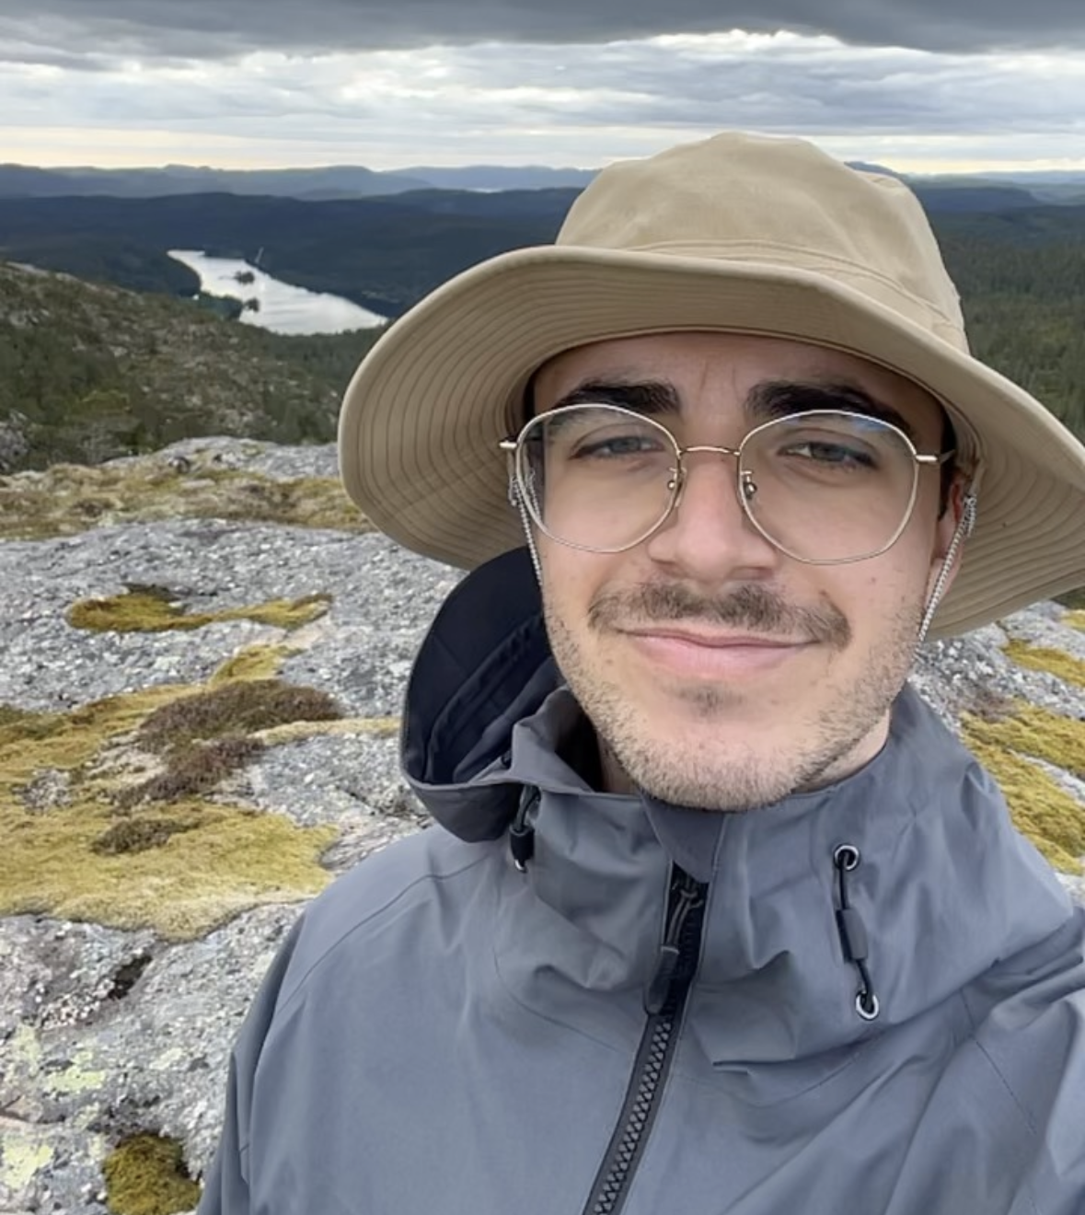





Marco Bach
University: Karlsruhe University of Applied Sciences
Study program: Mechanical Engineering - Bachelor
Year of study: 3.5 years / 7 semesters
City: Karlsruhe, Germany
Motto for life: Just go with the flow and enjoy life
Hobbies: Hiking, weight training, jogging
Your expectations from the summer school:
Learn exciting and up-to-date things about sustainability and the environment
Location where I study, work
live
Karlsruhe
31 August to 11 September 2026

